Slide 1
DigiClips
Derek Brandt
Tyler Orman
Israel Sanchez
Aryan Rao

Slide 2
Agenda
Project Overview
Problem Statement
Personas
User Needs

Slide 3
Project Overview

Slide 4
Project Overview
DigiClips is striving to be a website that catalogs diverse media content
including news coverage, advertisements, radio broadcasts, and podcasts.
Our team’s primary objective centers on revitalizing
the administration portal which oversees
user and server status.

Slide 5
Problem Statement

Slide 6
Problem Statement
Three main challenges for the team:
Lack of proficiency in Angular framework
UI design feedback from Digiclips
Ensure all components work properly after new design is implemented

Slide 7
Personas

Slide 8
Lee Roy
Age: 35
Occupation: Advertisement Agency
Location: Des Moines, IA
Roy needs statistics of how their ads are performing.
They’ll produce reports for clients with that information.

Slide 9
Lawyer McLaw
Age: 45
Occupation: Corporate Lawyer
Location: Wallstreet
Works for large company.
Needs to get notifications any time
their employer is on the news.

Slide 10
Lem Meout
Age: 50
Occupation: Drifter/IT Administrator
Location: Depends
Lem travels around the country and works remotely for a company that provides a “one-stop-shop” for media and news consumption.

Slide 11
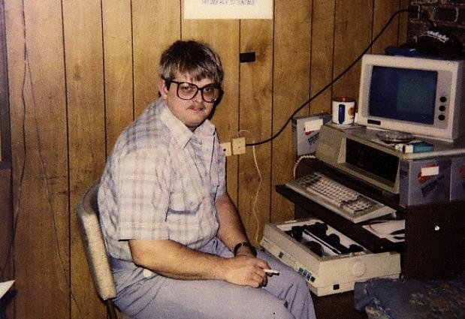
Dave from Accounting
Age: 25
Occupation: Software Engineer
Location: Works remotely
Greg works remotely and is

Slide 12
User Needs

Slide 13
User Needs
Easy to use controls
Logical layout of components
User statistics should be customizable
Server status should be easy to find
Information should be up-to-date
Scalable software
Easy to maintain the software

Slide 14
Conclusion

Slide 15
Conclusion
Objective is to create an administrative portal for
User Monitoring
Machine Status
Statistics
Users fall into global users and admin portal users.
We will primarily target admin users.

